Slide 1


MapSynth: Satellite to Map Image Translation
Subham Adhikari

Slide 2

Introduction
Maps are essential for navigation.
Traditional methods are slow and error-prone.
With deep learning, these can be automated.
Image-to-image translation is converting images from one domain to another

Slide 3
Project Overview
Goal: Automatically convert satellite images into corresponding map views.
Approach: Image translation using a Generative Adversarial Network (GAN) — specifically, Pix2Pix architecture.

Slide 4
Pix2Pix Architecture
Generator:
U-Net with encoder-decoder structure and skip connections.
Discriminator:
PatchGAN — evaluates 70×70 pixel patches for high-frequency detail.
Loss Functions:
Adversarial Loss
L1 Loss
BCE Loss

Slide 5

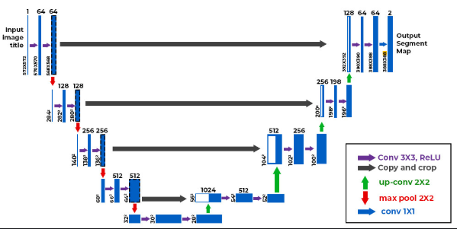
U-NET
Encoder (Downsampling):
Series of convolutional layers with kernel size 4, stride 2, and padding 1.
Activation: LeakyReLU
Downsamples input image and extracts deep spatial features.
Bottleneck:
Acts as a compressed feature representation layer.
Decoder (Upsampling):
Transposed convolutional layers with skip connections
Activation: ReLU
Reconstructs the image while preserving spatial details.
Output Layer:
Final transposed convolution followed by Tanh activation.

Slide 6
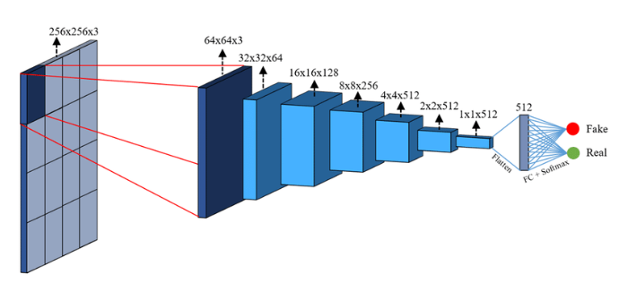
PatchGAN
Convolutional Layers:
Kernel size 4, stride 2, padding 1.
Activation: LeakyReLU
Gradually reduces spatial dimensions while increasing feature depth.
Final Convolutional Layer:
Outputs a feature map where each value represents the authenticity score of a 70×70 pixel patch.
Allows the discriminator to focus on local texture details rather than the whole image at once.

Slide 7
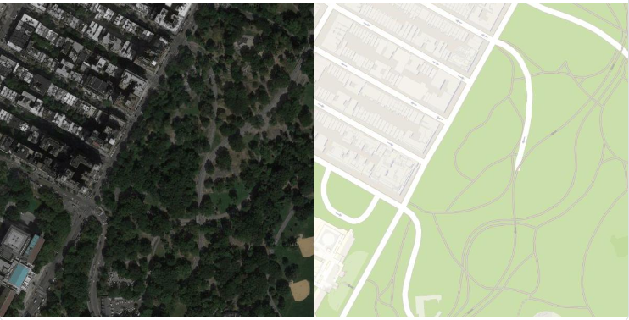
Datasets
Source: UC Berkeley, via web scraping from Google Maps.
Specifications:
2,194 images (600×600 satellite + 600×600 map)
Total size: ~257.7 MB
Use: Paired data for Pix2Pix training.

Slide 8
Data Preprocessing Steps
Image splitting (satellite & map halves)
Resize to 256×256 pixels
Horizontal flip (50%)
Color jitter (20%)
Normalization (-1 to 1)
Conversion to tensors

Slide 9
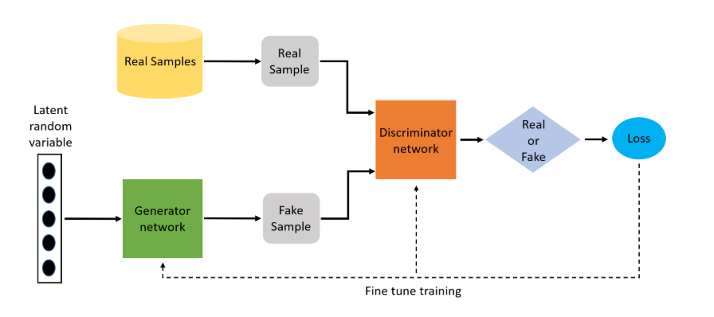
Adversarial Training Strategy
Adversarial Training Workflow
The training involves two neural networks — Generator and Discriminator — competing in a minimax game.
Both models are trained alternately to improve their respective performances:
The Generator aims to produce realistic map images from satellite images.
The Discriminator attempts to distinguish between real (ground truth) and generated (fake) image pairs.

Slide 10
Training Steps
Discriminator Training
Receives both real image pairs and fake pairs.
Calculates (BCE) loss and optimizes the parameter
Generator Training
Passes the generated image through the Discriminator to compute Adversarial Loss.
Also, computes L1 Loss to ensure pixel-level accuracy.
Combines both losses (weighted) to update the Generator parameters.
Optimization Approach
Adam optimizer used for both networks. Training is conducted over 50 epochs.

Slide 11
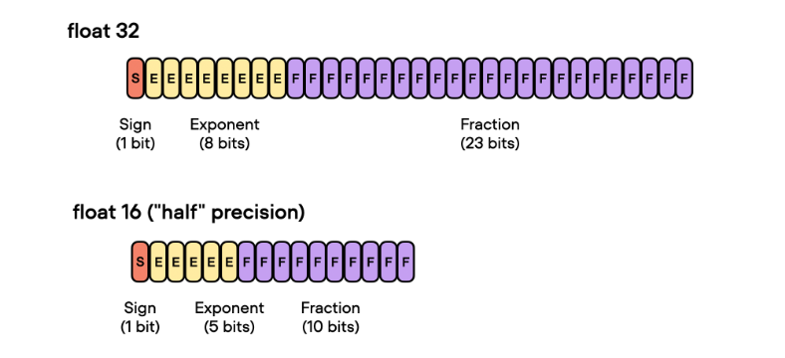
Automatic Mixed Precision Training
A training optimization technique that uses a combination of 16-bit (half-precision) and 32-bit (single-precision) floating-point numbers during model training.
Helps speed up training and reduce memory consumption without compromising model accuracy.

Slide 12
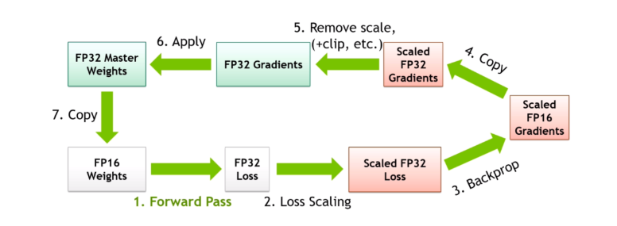
AMP Training Workflow

Slide 13

Results & Evaluation
Metrics Used:
SSIM: 0.572
PSNR: 26.78 dB
Interpretation:
Moderate structural similarity and visual fidelity.
Could be improved with more diverse data or alternative architectures.

Slide 14
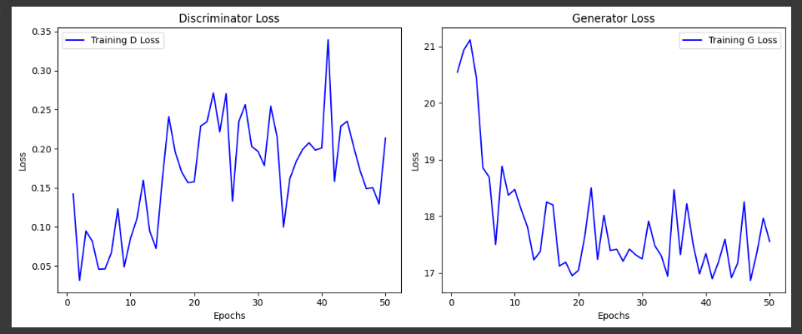
Loss Curve

Slide 15
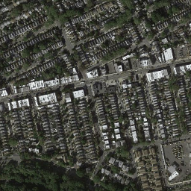
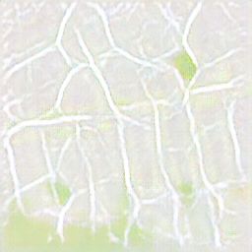
Visual Results
Model Input
Model Output

Slide 16
DEMO

